Slide 1
Tabular learning
Hangting Ye

Slide 2
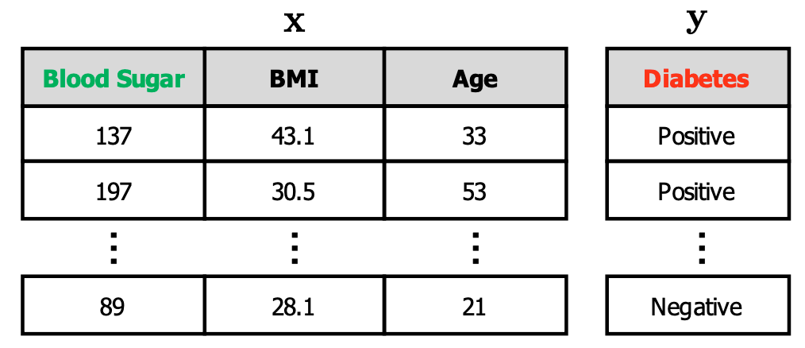
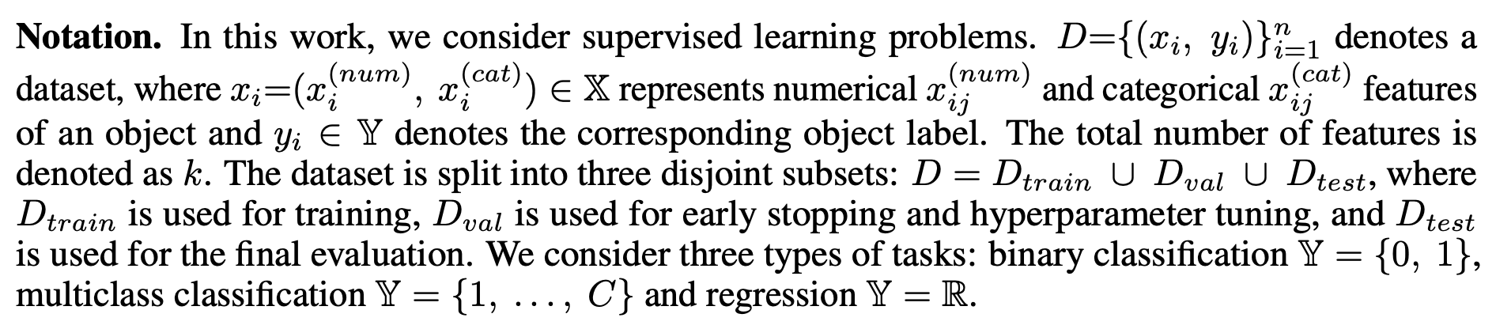
What is tabular learning?
Tabular dataset

Slide 3
Tree-based methods
GBDT, LightGBM, XGBoost
ML competitions like kaggle

Slide 4
Why still explore deep learning?
Potential higher performance of deep learning
It would allow constructing multi-modal pipelines for problems, where only one part of the input is tabular, and other parts include images, audio and other DL-friendly data.

Slide 5
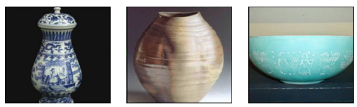
Challenges for deep learning on tabular data
Data heterogeneity
Unbounded per column (data preprocessing)
Continues and category
High or low Correlation between different columns
Number of columns unknown
Per sample, a few information is provided, compared to cv, nlp.

Slide 6
Contents
Recent research that could be applied in tabular learning
Research lines for tabular learning

Slide 7
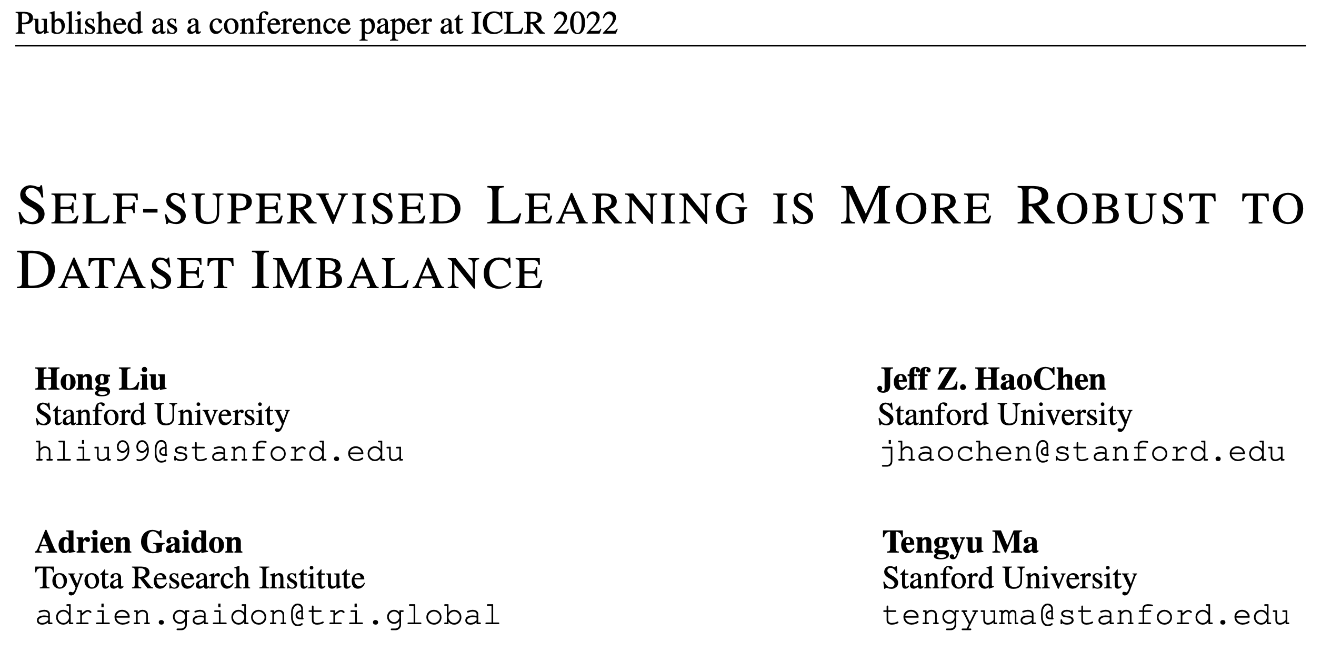

Slide 8
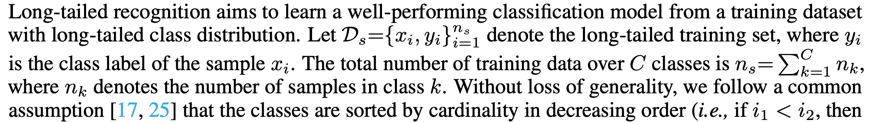
Imbalance learning

Slide 9
Motivation
The performance of vanilla supervised methods degrades significantly on class-imbalanced datasets. Many recent works address this issue with various regularization and re-weighting/re-sampling techniques.
The behavior of SSL algorithms under dataset imbalance remains largely underexplored in the literature.

Slide 10
Off-the-shelf SSL representations are already more robust to dataset imbalance than the representations learned by supervised pretraining

Slide 11
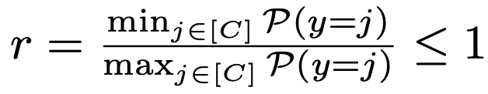
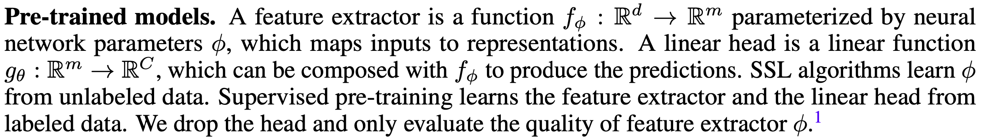
Pre-train the SL/SSL conduct in-domain (ID) / out-of-domain (OOD) evaluation
Notation.

Slide 12
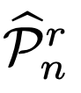
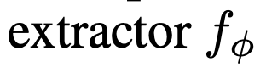
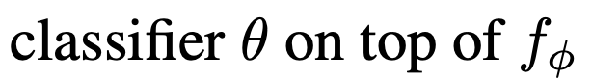
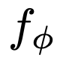
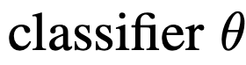
CIFAR-10
train
val
test
Pre-train
Long tail variant
sample
and train SSL/SL to obtain
CIFAR-10
train
val
test
ID
balanced
balanced
train
evaluation
STL-10
train
val
test
OOD
balanced
balanced
train
&
evaluation

Slide 13
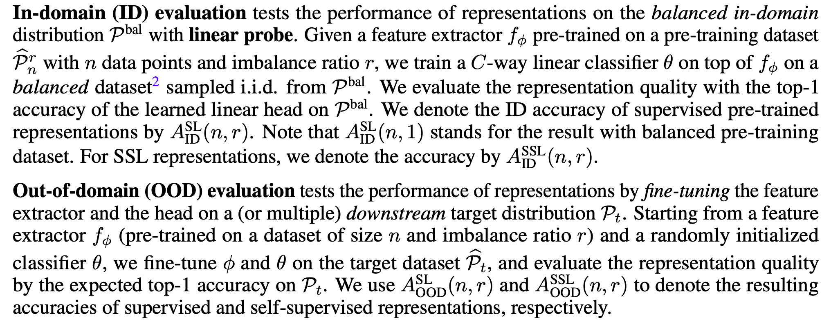

Slide 14
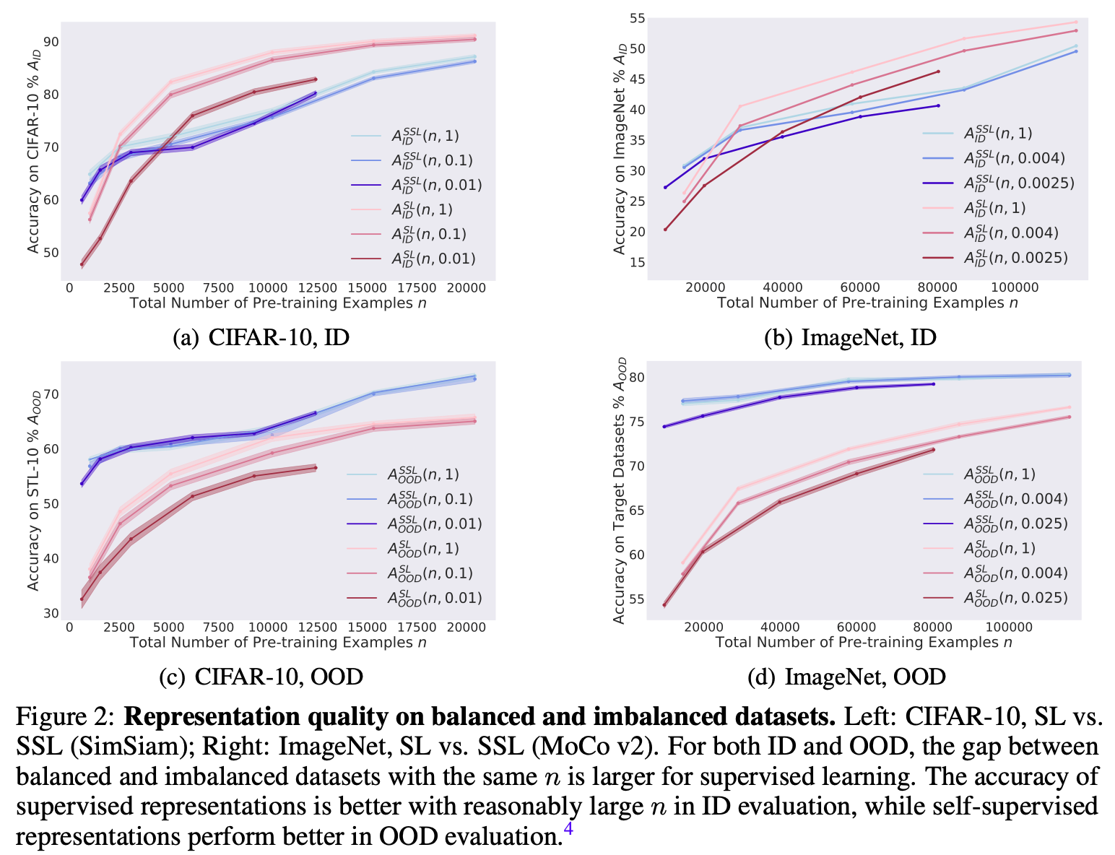

Slide 15
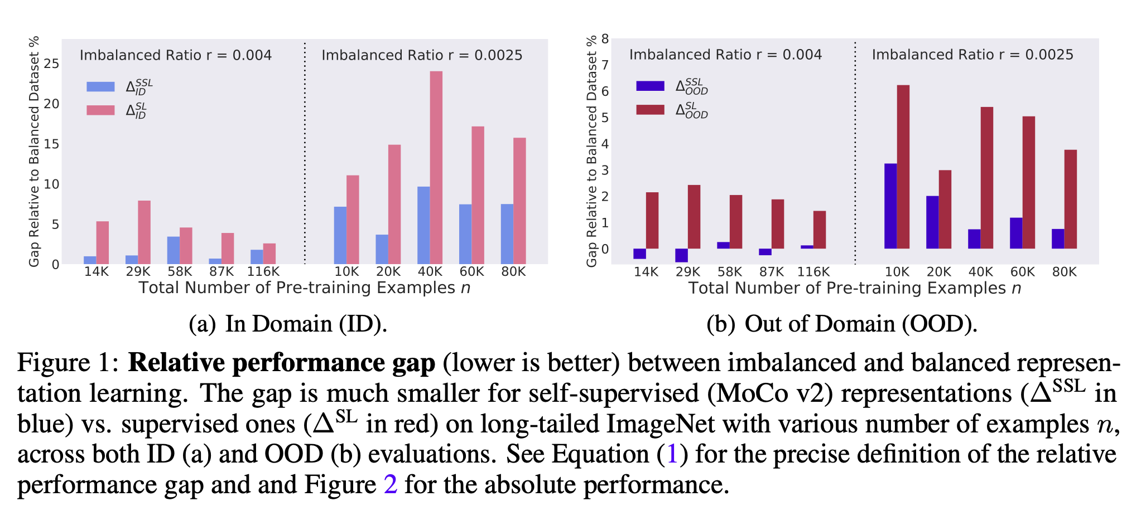

Slide 16
Analysis
SSL learns richer features from frequent data that are transferable to rare data.
supervised model mainly learns the features that help classify the frequent classes and may neglect other features which can transfer to the rare classes.

Slide 17
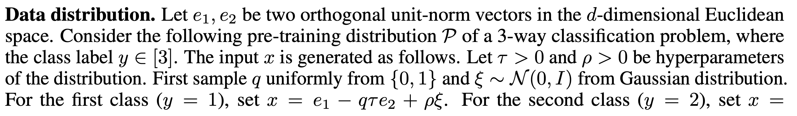
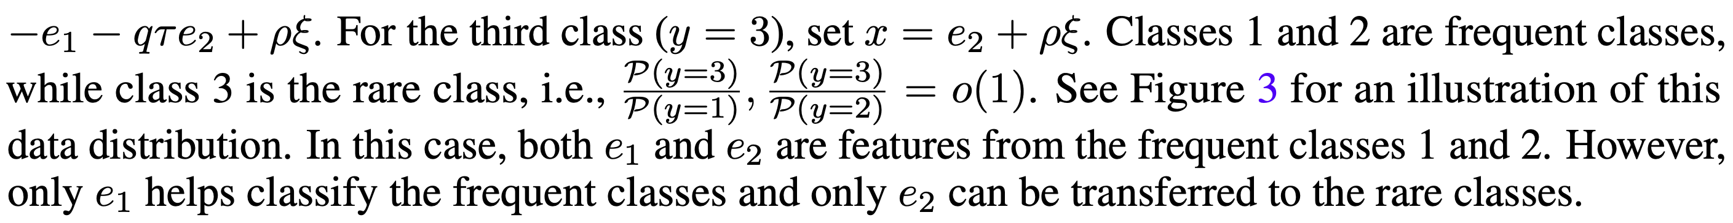
Rigorous Analysis on A Toy Setting

Slide 18
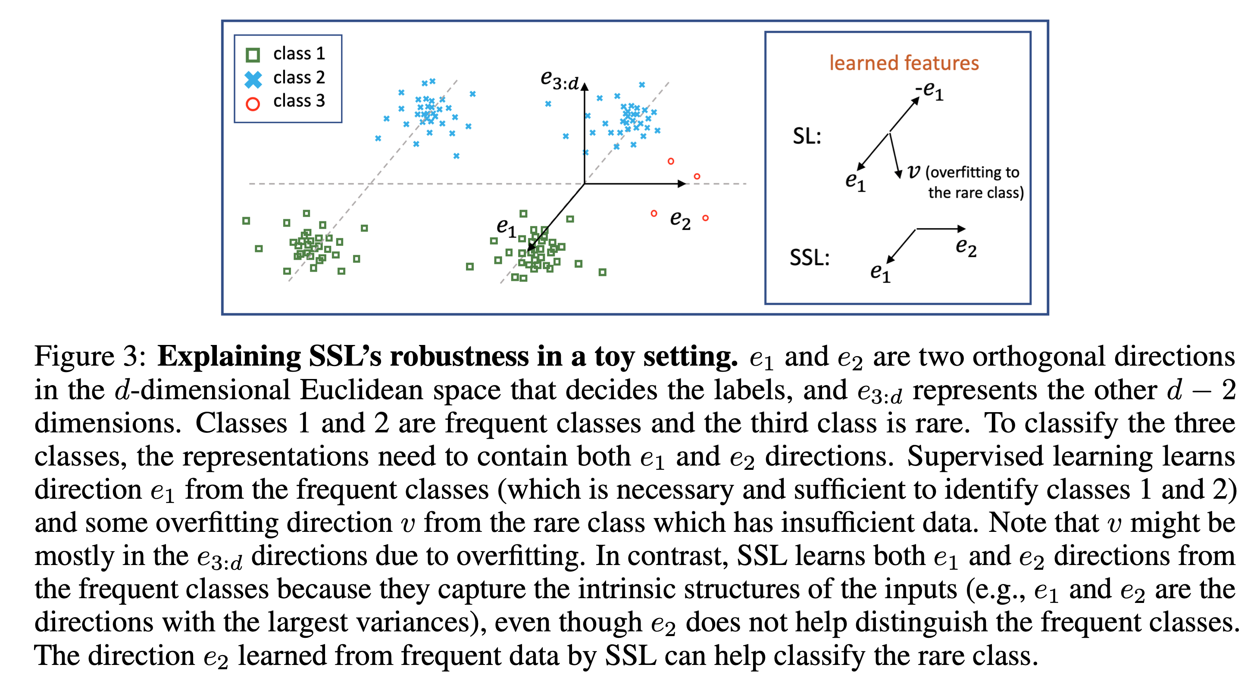

Slide 19
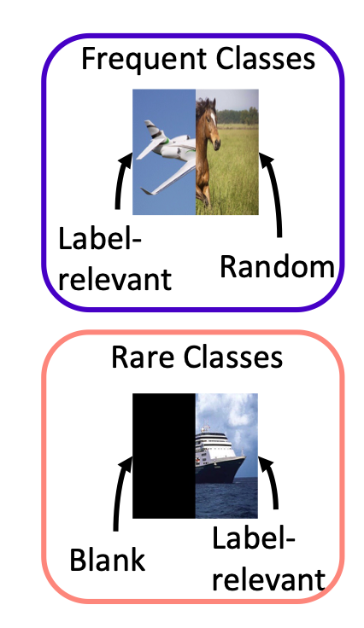
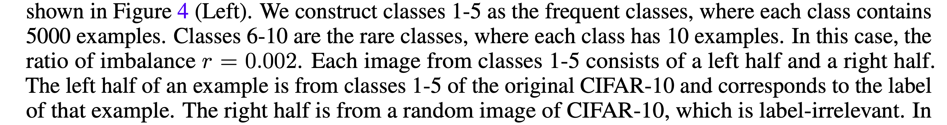
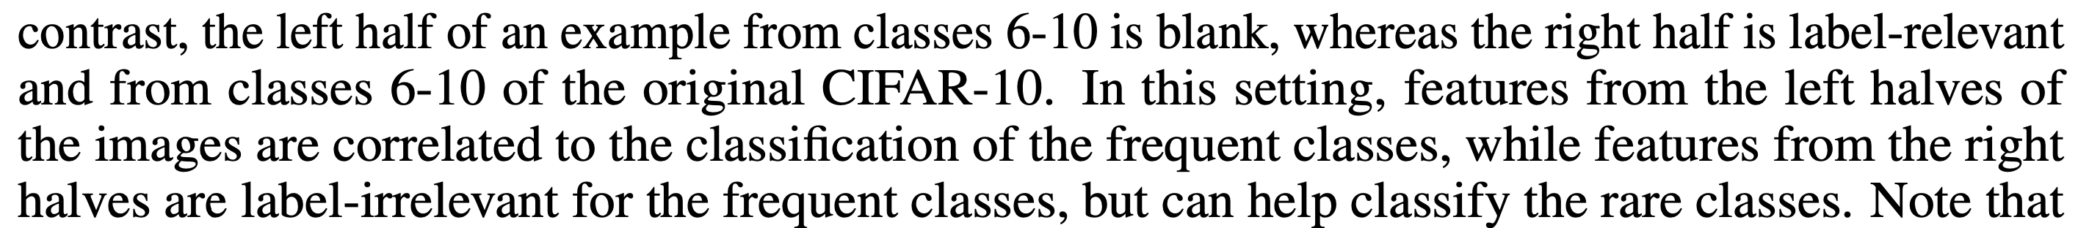
Illustrative Semi-Synthetic Experiments

Slide 20
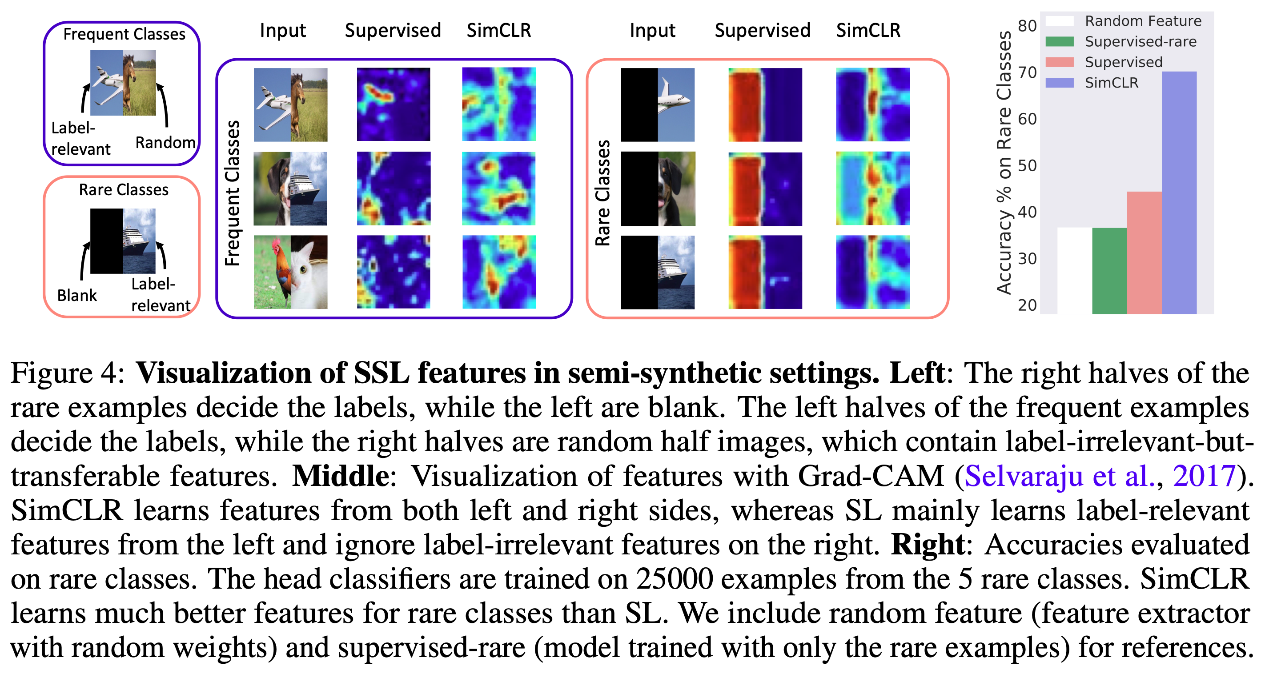

Slide 21
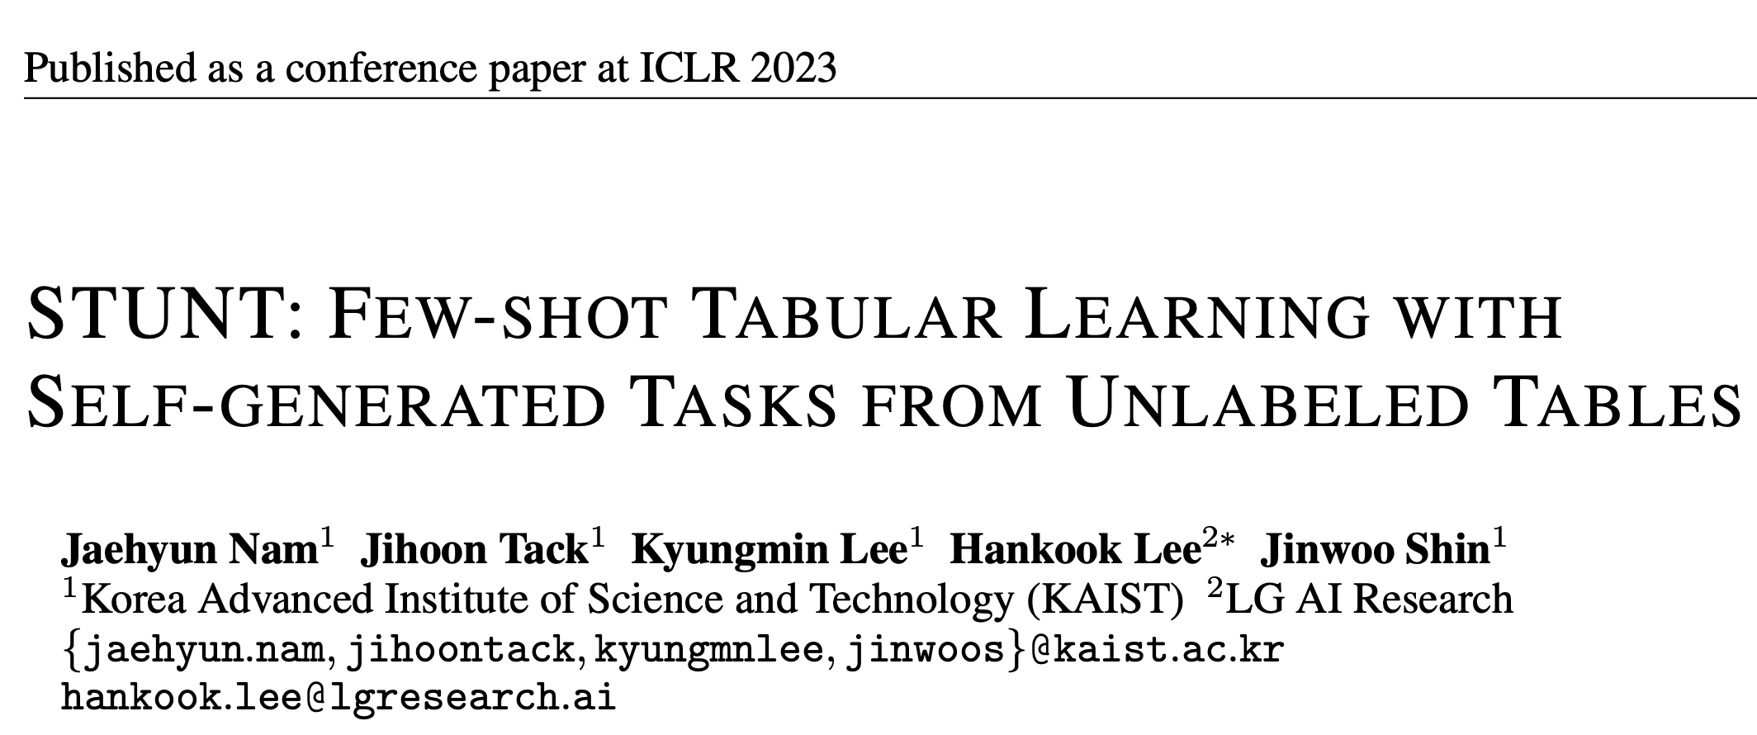

Slide 22
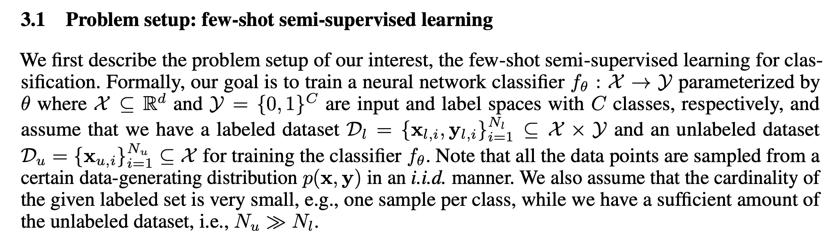

Slide 23
Task generation from unlabeled tables
Intuition 1: any label type can be considered as a tabular column due to the heterogeneous characteristic of the tabular data (i.e., each column has a distinct feature)
Intuition 2: since there exist some columns that have a high correlation with the original label, the new task constructed with such a column feature is highly similar to the original classification task

Slide 24
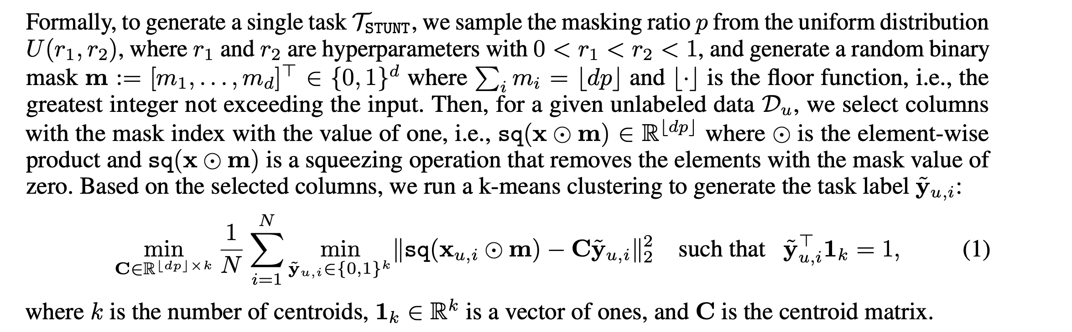
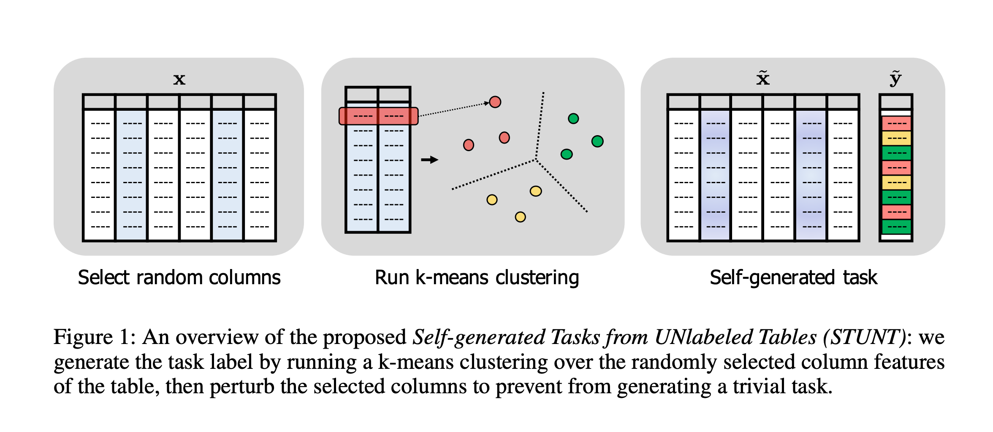
Task generation from unlabeled tables

Slide 25
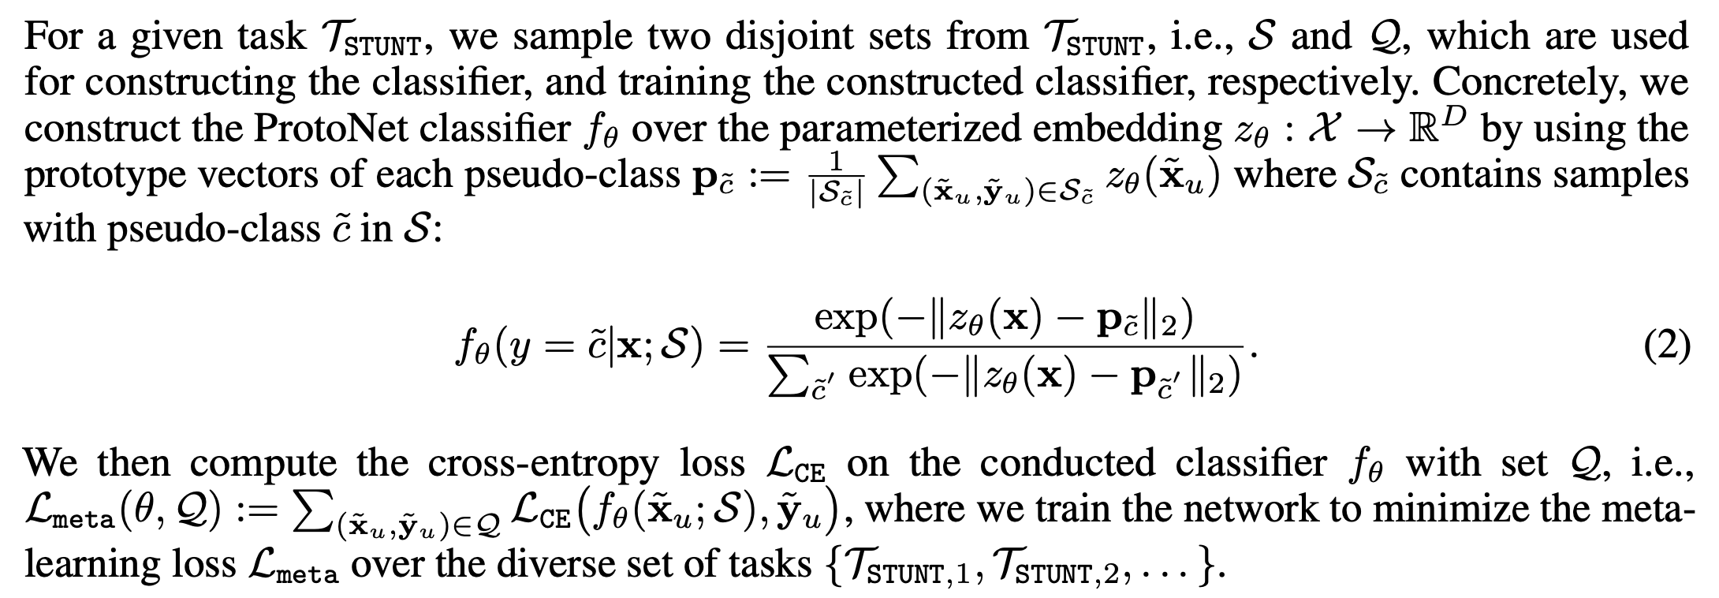
Meta-learning with STUNT

Slide 26
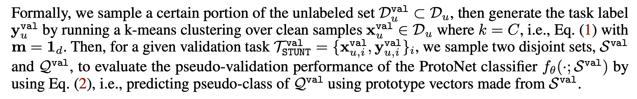
Pseudo-validation with STUNT

Slide 27
Adapting with labeled samples

Slide 28
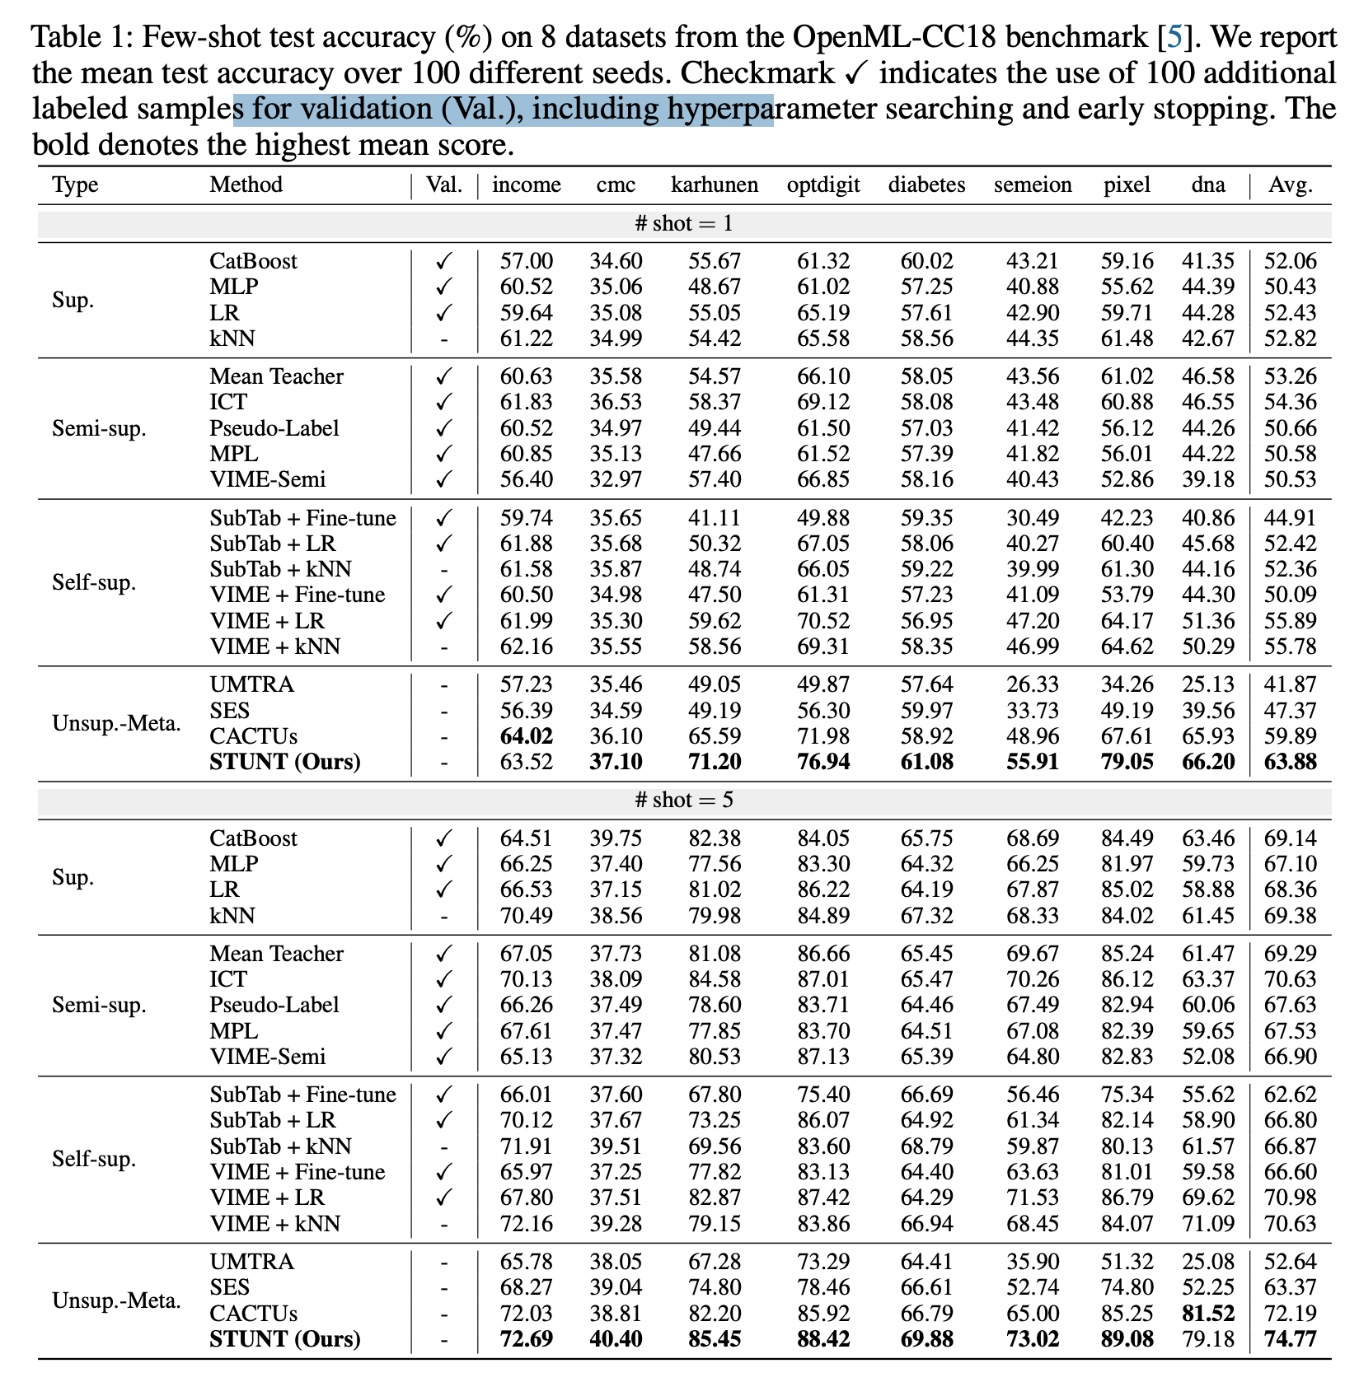
Experiment

Slide 29
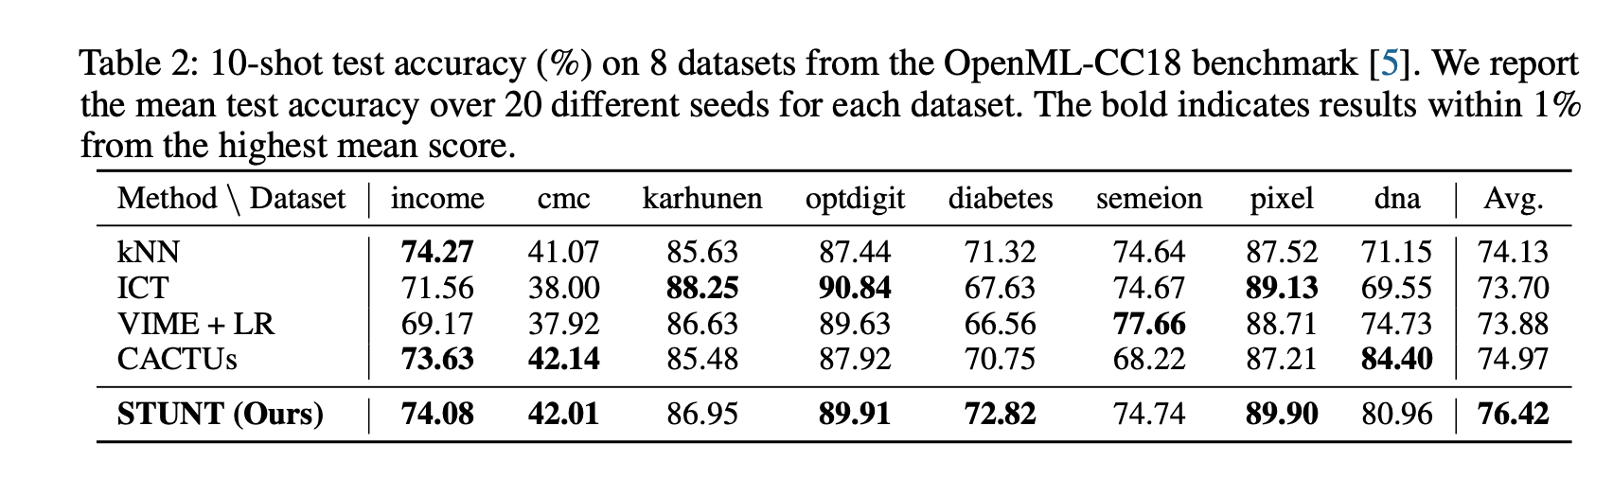
Experiment

Slide 30
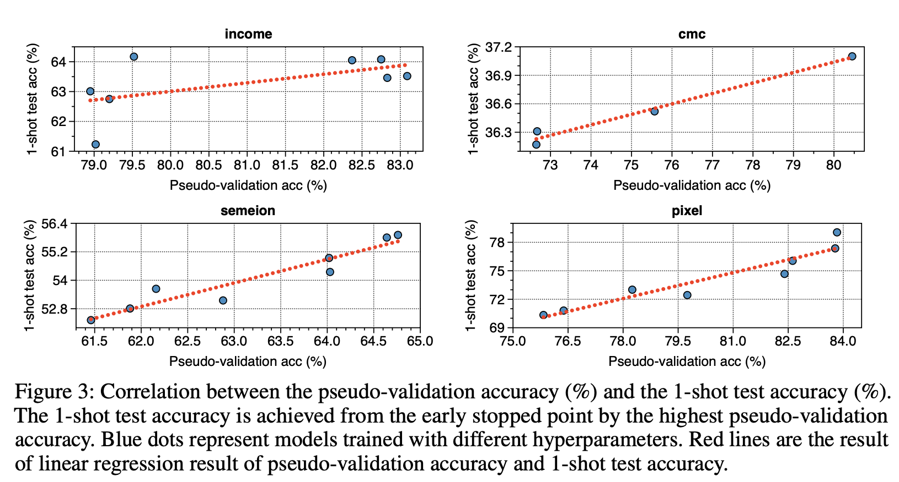
Experiment

Slide 31
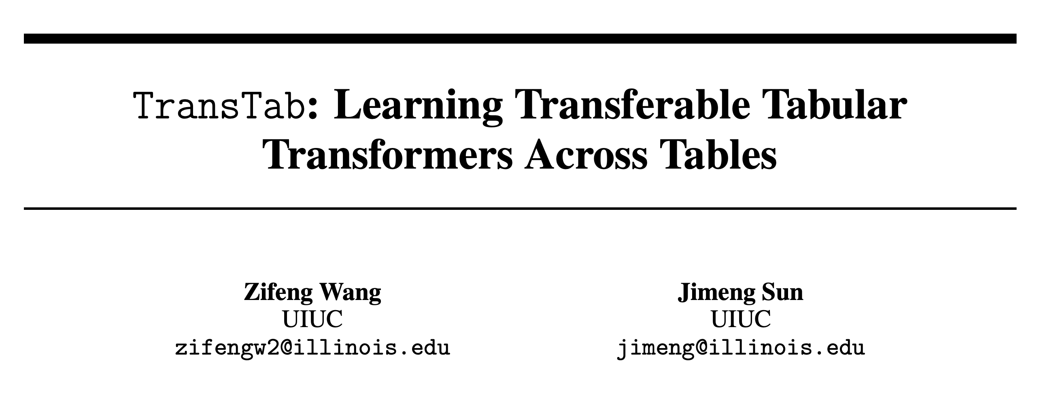

Slide 32
Motivation
Existing tabular work requires the same table structure in training and testing
Learning across tables need to remove non-overlapping columns
There is a wide application for learning across different tables.

Slide 33
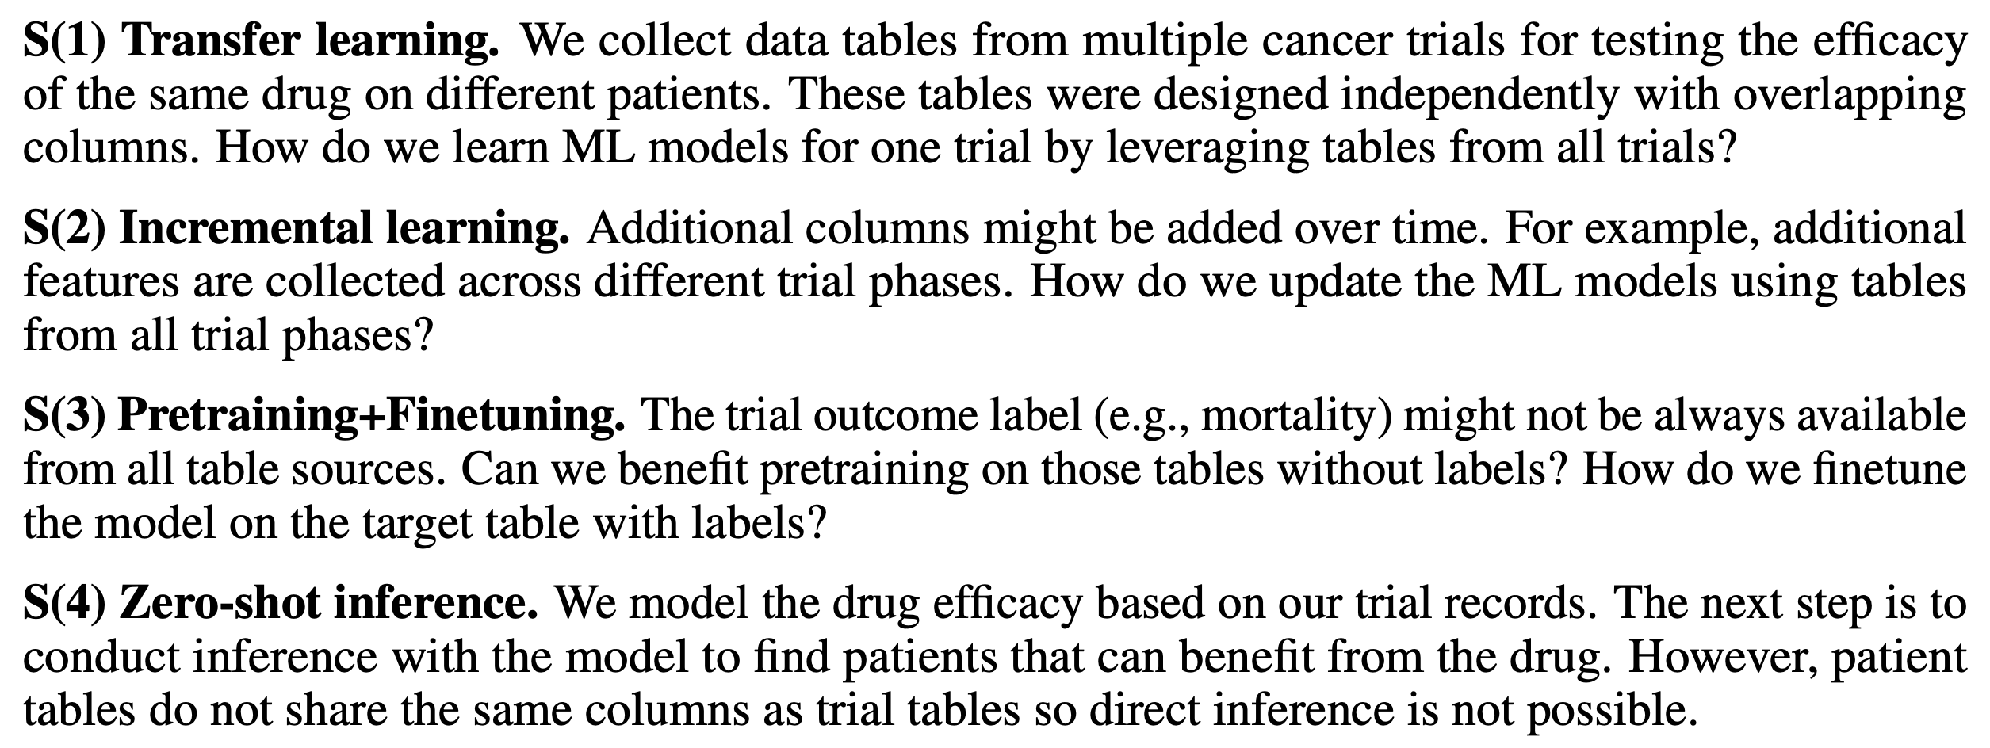

Slide 34
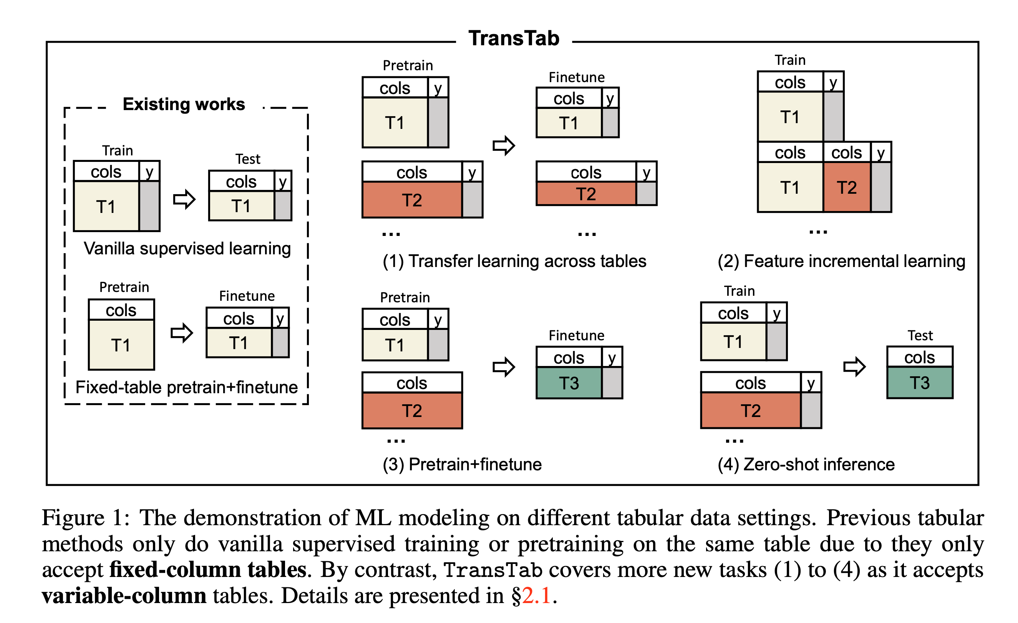

Slide 35
Insight
convert tabular data (cells in columns) into a sequence of semantically encoded tokens
The column name is related to text information
Adapt the classic transformer in NLP to tables
For example, if a cell in column smoking history has value 1, it indicates the individual has a smoking history. Similarly, cell value 60 in column weight indicates 60 kg in weight instead of 60 years old

Slide 36
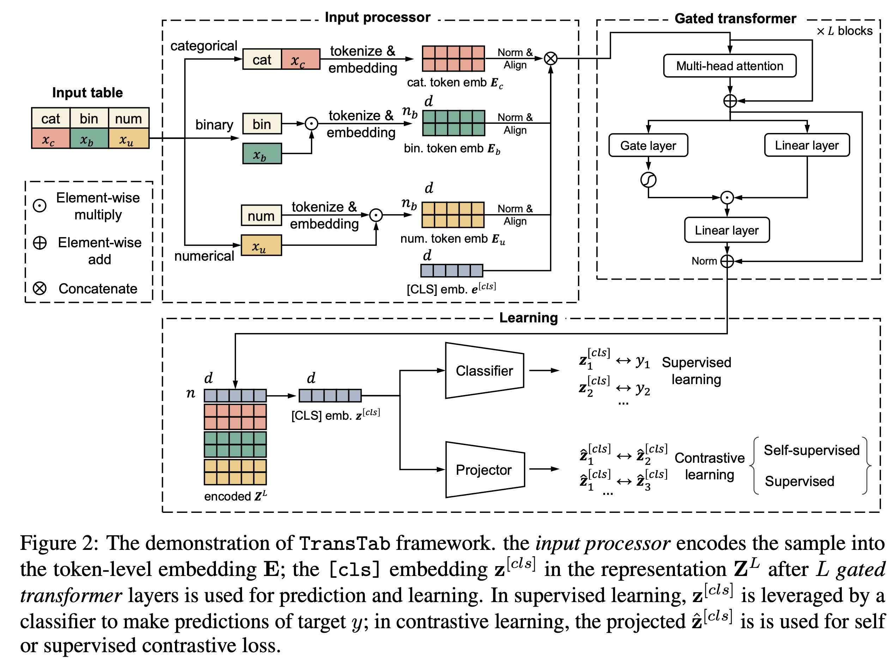

Slide 37
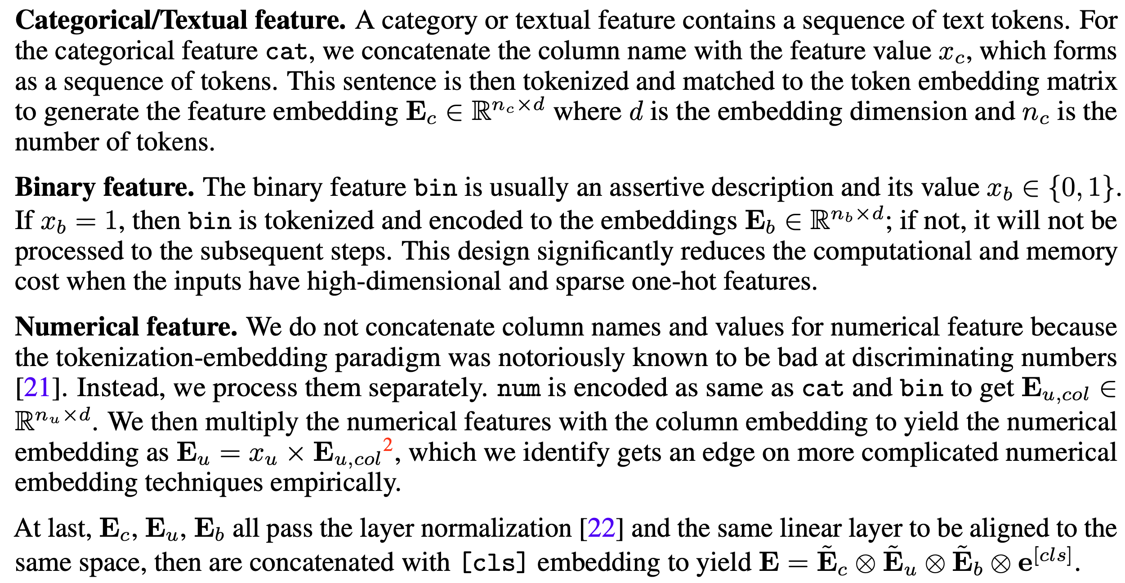

Slide 38
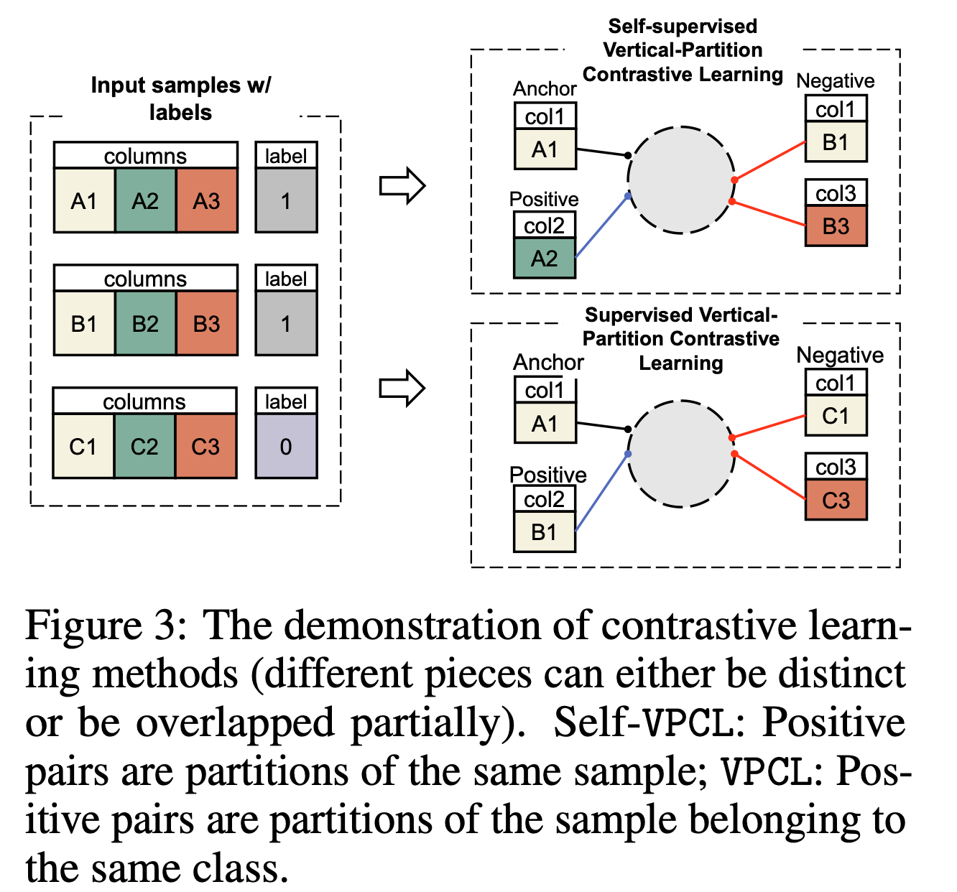
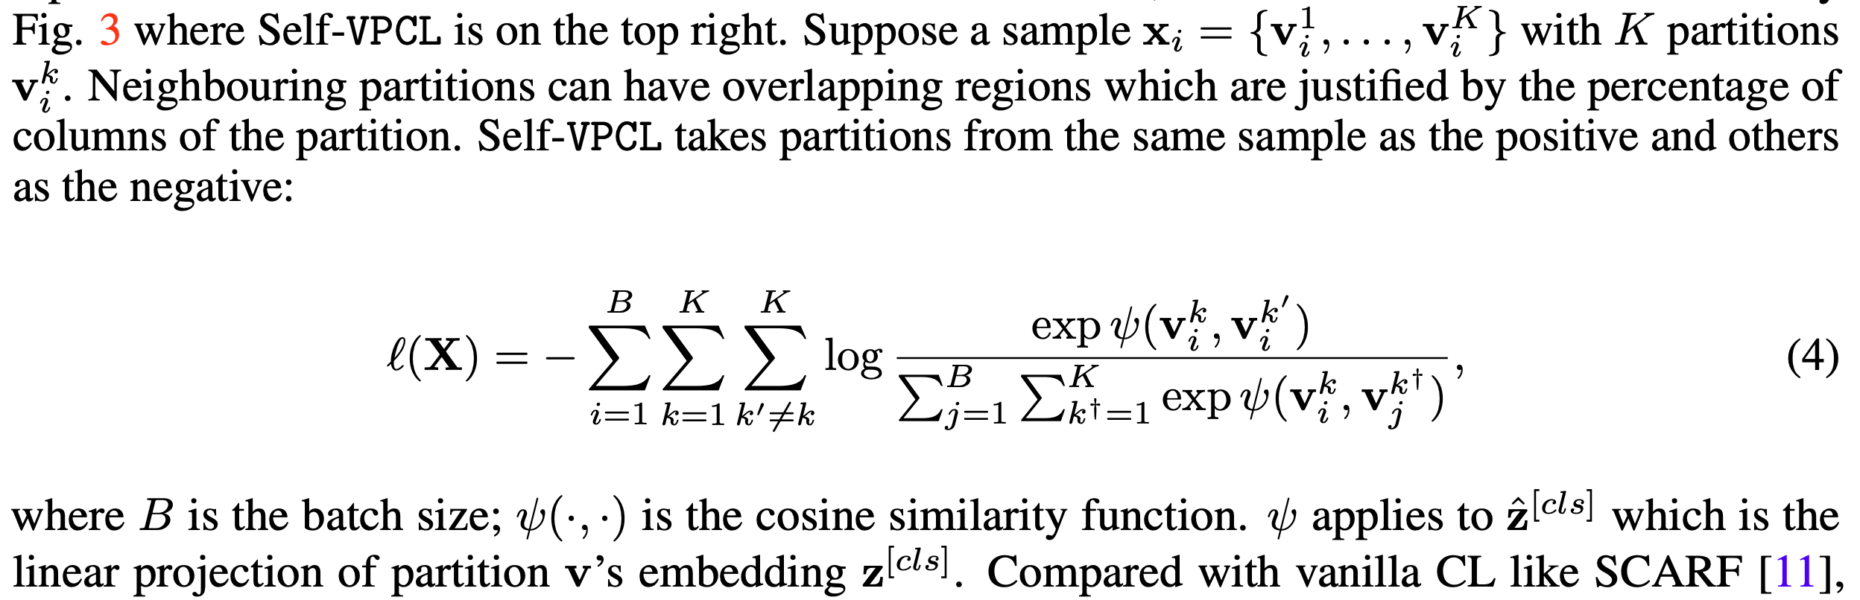
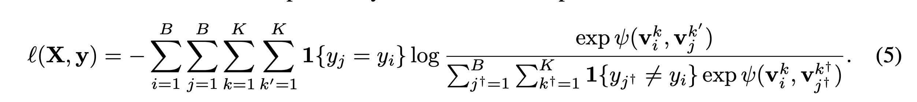
Contrastive learning
Motivation: For SL, to prevent bias modeling to a specific task, as the setting is learn across tables.

Slide 39
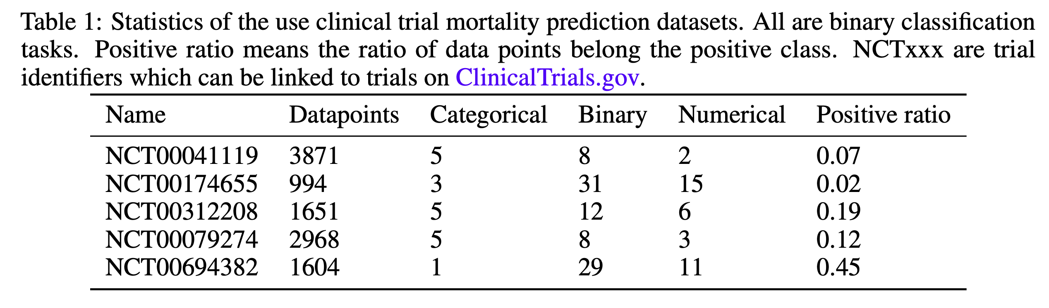
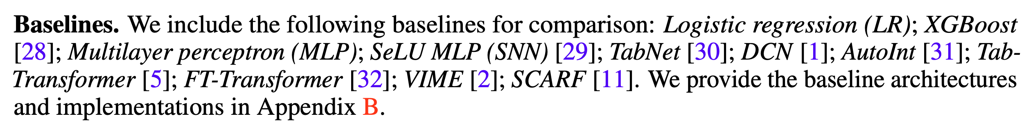
Experiment

Slide 40
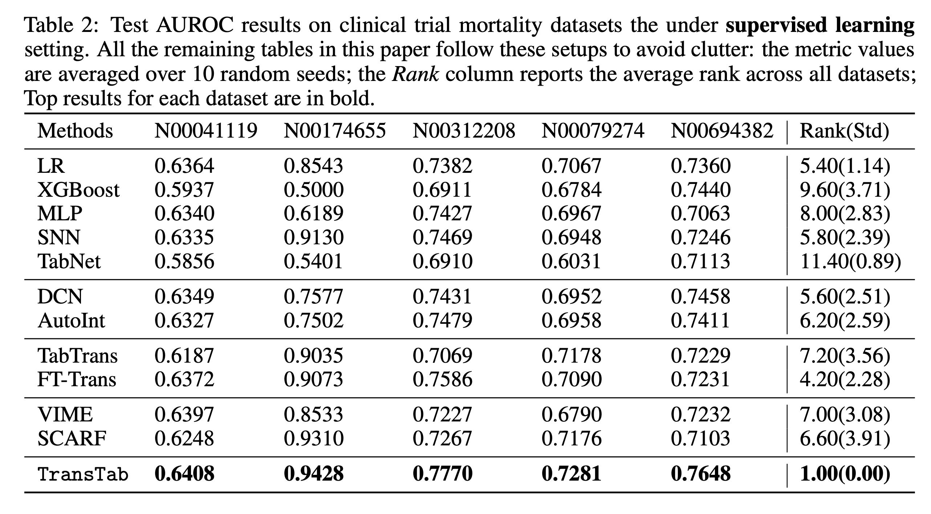
Experiment

Slide 41
Research Lines for Tabular learning
Imbalance learning
Few shot
Anomaly detection
Representation learning
Preprocessing

Slide 42
Supervised manner
Imbalance learning
Re-sample
Re-weighting
Ensemble methods
Meta-learning
Data augmentation (mainly for vision)
Unsupervised manner
Self learning

Slide 43
Re-sampling Resampling methods focus on modifying the training set to balance the class distribution
Traditional distance-based machine learning methods
GANs based over-sampling methods for CV domain
Representation over-sampling methods
Over sampling
Under sampling

Slide 44
Traditional methods
SMOTE: Synthetic Minority Over-sampling Technique, Journal of Artificial Intelligence Research 2002
The variants of SMOTE
e.g. Borderline-SMOTE, which oversamples the minority samples near class borders,
Safe-level-SMOTE, which defines safe regions not to oversample samples from different classes

Slide 45
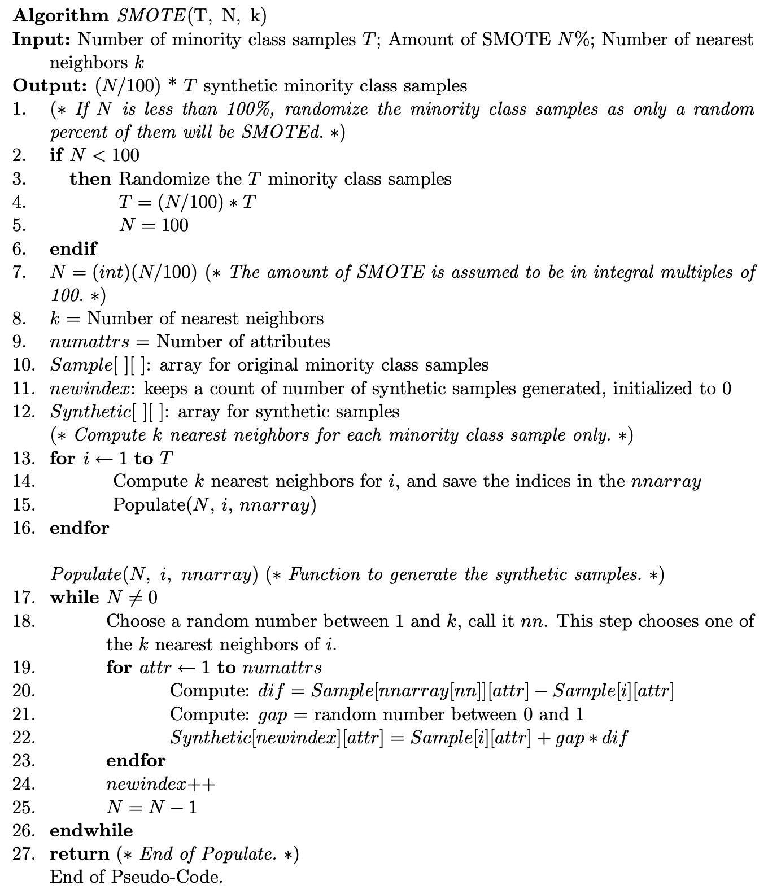
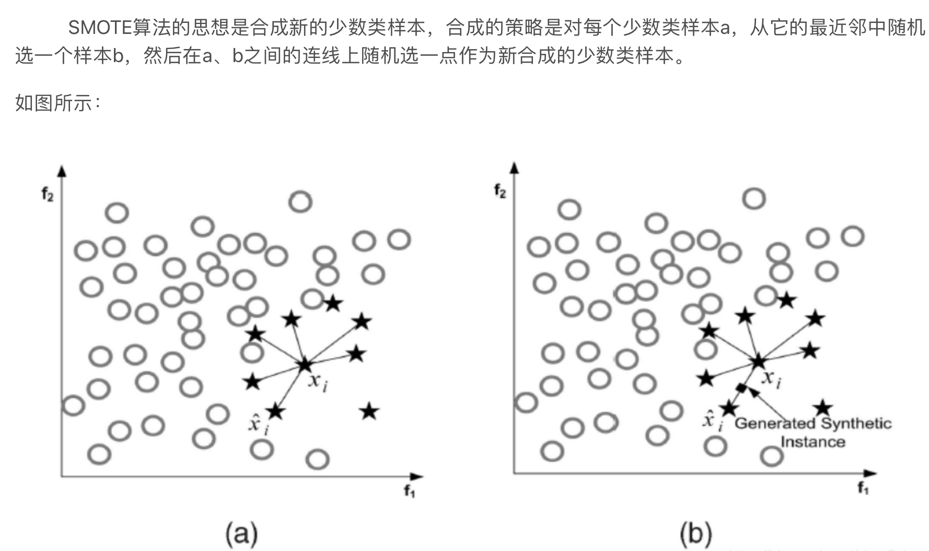

Slide 46
GANs based over-sampling methods
Generative adversarial minority oversampling, ICCV 2019
producing new minority samples by training a convex generator
Blt: Balancing long-tailed datasets with adversarially-perturbed images, ACCV 2020
proposed adversarial augmentations by adding small noise to the input images

Slide 47
Representation over-sampling methods
Deep Over-sampling Framework for Classifying Imbalanced Data, Machine Learning and Knowledge Discovery in Databases 2017, for CV
Feature space augmentation for long-tailed data, ECCV 2020
aim to augment minority classes in the feature space by sampling from the in-class neighbors in the linear subspace, using learned features from pretrained networks

Slide 48
Re-weighting
Reweighting methods typically adjust the weights of instances or classes that calibrates the classifier predictions to be balance.
Empirical Re-weighting. (to provide the examples of each class with the same weight, such as inverse class frequency )
Learning deep representation for imbalanced classification (CVPR, 2016)
Learning to model the tail (NeurIPS, 2017)
Focal loss for dense object detection (ICCV, 2017)
Class-balanced loss based on effective number of samples (CVPR, 2019)
Learning Imbalanced Datasets with Label-Distribution-Aware Margin Loss (NeurIPS, 2019)
Automatic Re-weighting. (in sum, iteratively update weights and model parameter)
Learning to Reweight Examples for Robust Deep Learning (PMLR, 2018)
Learning Data Manipulation for Augmentation and Weighting (NeurIPS, 2019) 是上一篇的变体
IMPROVING THE ACCURACY OF LEARNING EXAMPLE WEIGHTS FOR IMBALANCED CLASSIFICATION (ICLR, 2022) 是上一篇的变体
Learning to Re-weight Examples with Optimal Transport for Imbalanced Classification (NeurIPS, 2022)

Slide 49
Ensemble methods
Classic method
heuristic-based designs
most of the them are straight combinations of a resampling/reweighting solution and an en-semble learning framework
e.g. SMOTEboost
Recent work for CV domain
BBN: Bilateral-Branch Network with Cumulative Learning for Long-Tailed Visual Recognition
Learning from multiple experts: Self-paced knowledge distillation for long-tailed classification
Long-tailed recognition by routing diverse distribution-aware experts
Ace: Ally complementary experts for solving long-tailed recognition in one-shot

Slide 50
Meta-learning
Learns a dynamic loss function
Learning to Teach with Dynamic Loss Functions
Balanced meta-softmax for long- tailed visual recognition
An implicit/explicit data weighting function
Learning to reweight examples for robust deep learning
Meta- weight-net: Learning an explicit mapping for sample weighting
Meta augmentation
Metasaug: Meta semantic augmentation for long-tailed visual recognition
Learns a mini-batch curriculum
Mentornet: Learning data-driven curriculum for very deep neural networks on corrupted labels

Slide 51
Unsupervised manner (quantity & quality)
Self-learning
CV: Rethinking the Value of Labels for Improving Class-Imbalanced Learning. (NeurIPS 2020)
CV: Exploring Balanced Feature Spaces for Representation Learning. (ICLR 2021)
CV: Self-Damaging Contrastive Learning. (ICML 2021)
CV: Balanced Contrastive Learning for Long-Tailed Visual Recognition. (CVPR 2022)
CV: Self-Supervised Learning is More Robust to Dataset Imbalance. (ICLR 2022)
Graph: Co-Modality Graph Contrastive Learning for Imbalanced Node Classification. (NeurIPS 2022)

Slide 52
Few shot for tabular learning
Motivation
high labeling costs (the credit risk in financial datasets)
show difficulties in collecting new samples (a patient with a rare or new disease such as an early infected patient of COVID-19)

Slide 53
Few shot for tabular learning
Challenges
General domain approaches don’t work due to data heterogeneous
Specific successful method like cv domain can not transfer
Recall data augmentation and patches-based

Slide 54
Few shot
STUNT: FEW-SHOT TABULAR LEARNING WITH SELF-GENERATED TASKS FROM UNLABELED TABLES (ICLR 2023)
Relative representations enable zero-shot latent space communication (ICLR 2023)

Slide 55
Anomaly detection
ADBench: Anomaly Detection Benchmark (NeurIPS 2022)
UADB: Unsupervised Anomaly Detection Booster (ICDE 2023)

Slide 56
Representation learning
NLP domain method: TransTab: Learning Transferable Tabular Transformers Across Tables (NeurIPS 2022)

Slide 57
Future direction
Imbalance learning: self learning (quantity & quality)
Few shot: self learning (quantity & quality)
Anomaly detection (general boosting for UAD)
Representation learning (use successful transfer learning methods in CV & NLP domain)
Preprocessing (for deep learning)

